Slide 1
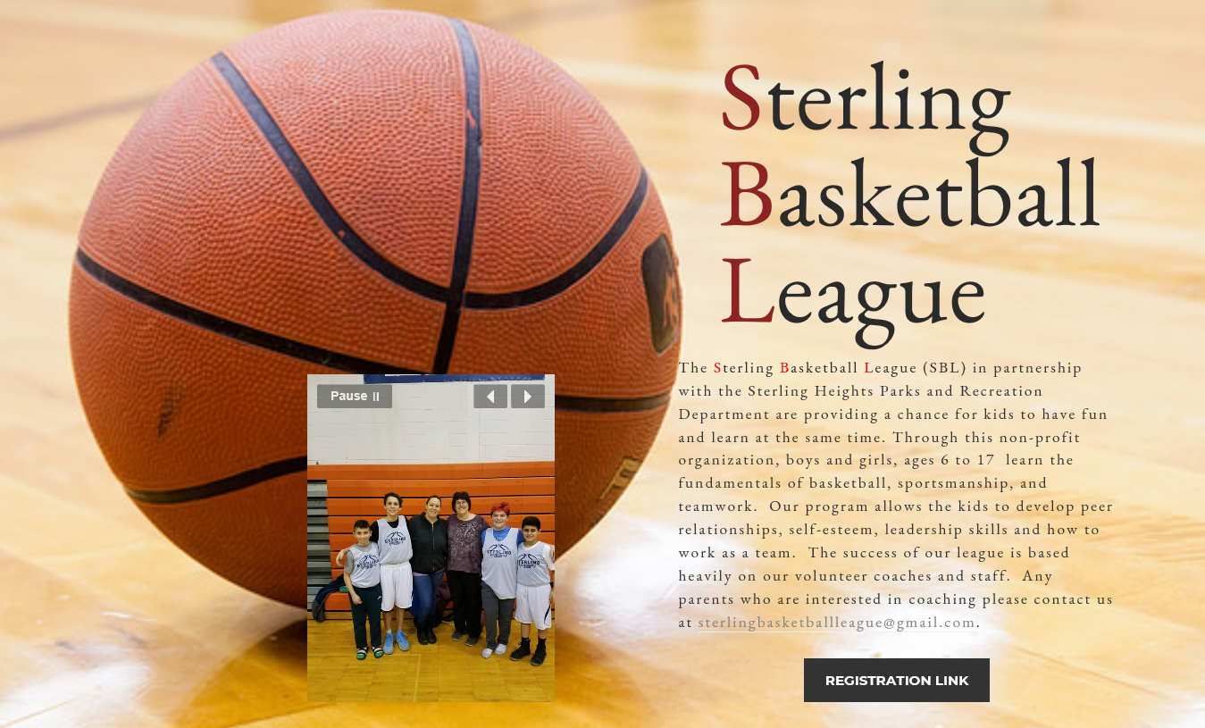
Step 1: Click Registration Link
Step 2: Select Register Now, All Programs

Slide 2
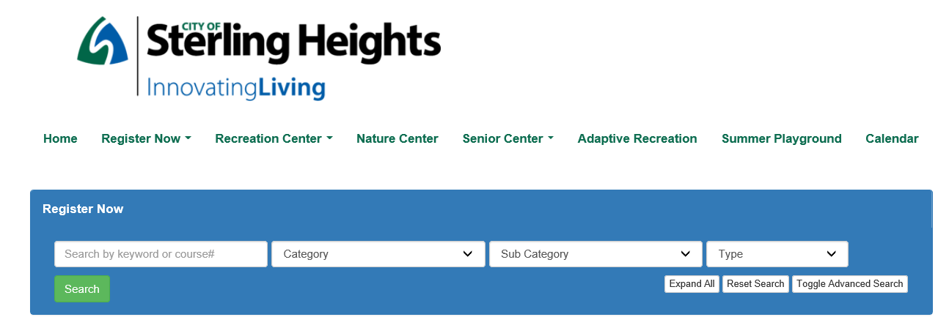
Step 3: Scroll down the page until you see Youth Basketball
Step 4: Click Youth Basketball and it will show you the following:

Slide 3
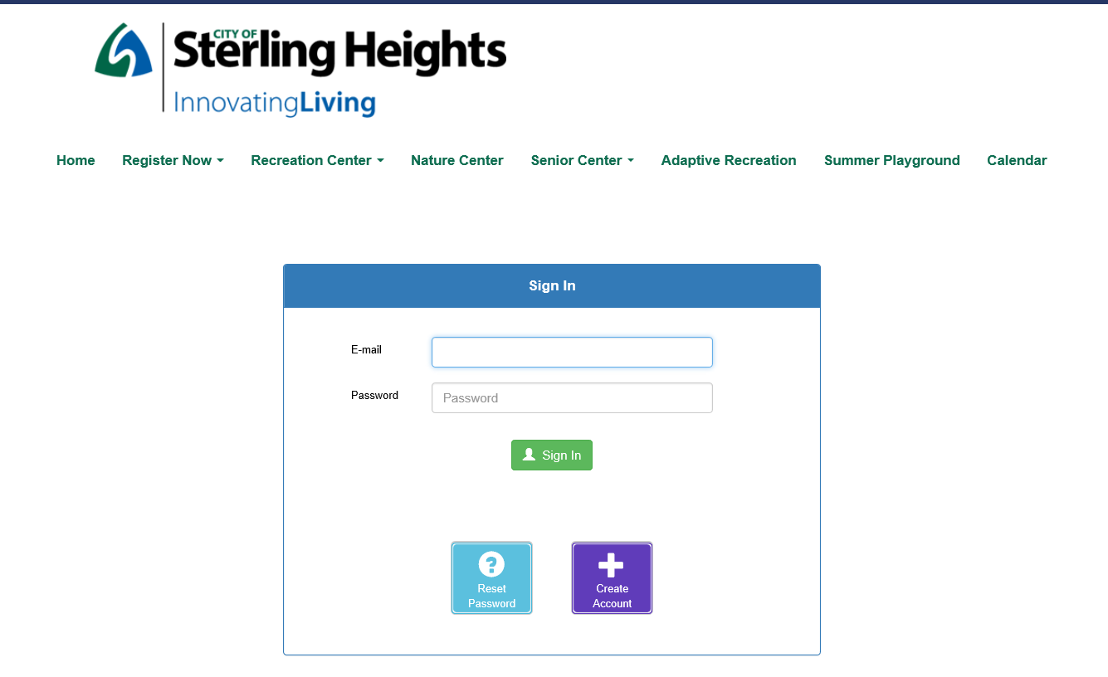
Step 5: Select the one that applies to your child. For this instruction we are using 12-18 years old.
Step 6: This next step it will ask you to sign in or create an account

Slide 4
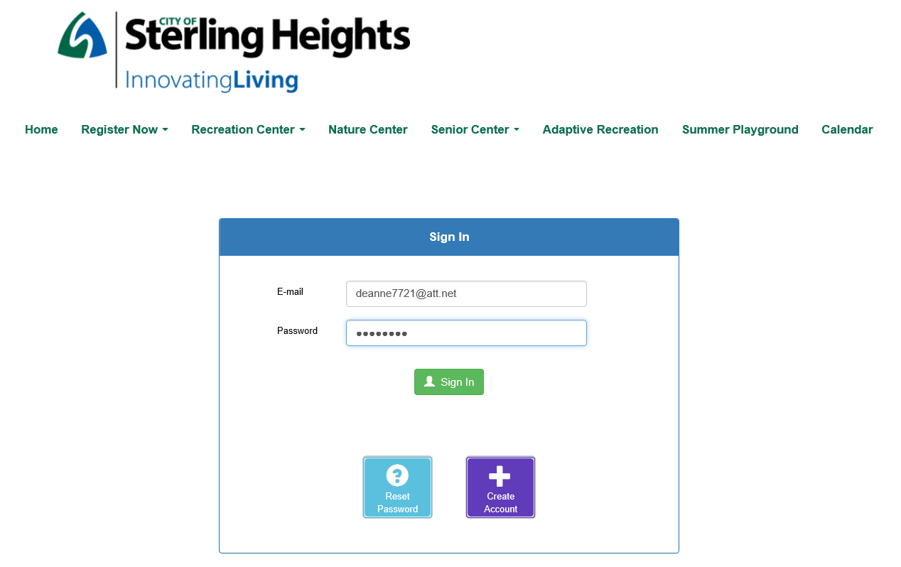
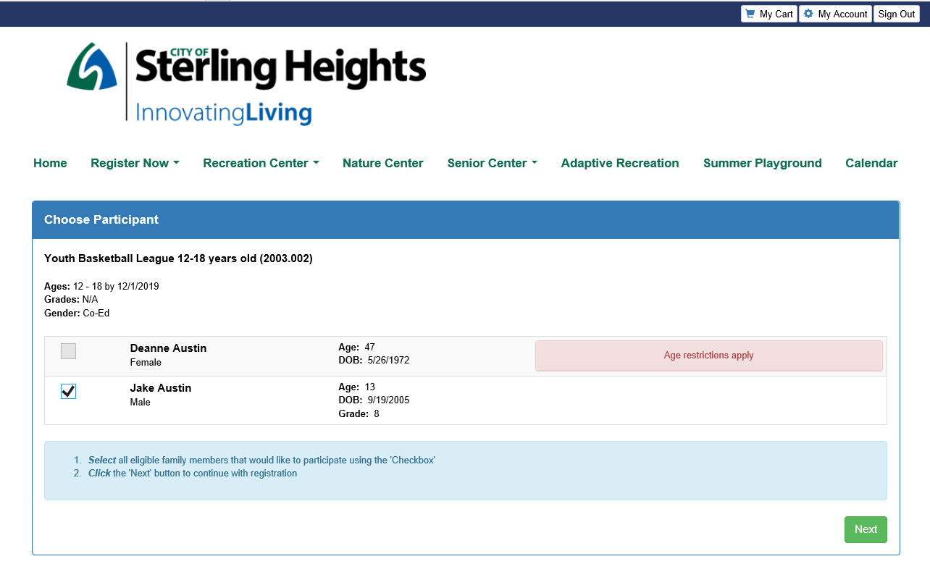
Step 7: We are using an account that is already set up for this example. Once you enter your email and password click Sign In:
Step 8: Select your child's name and click Next

Slide 5
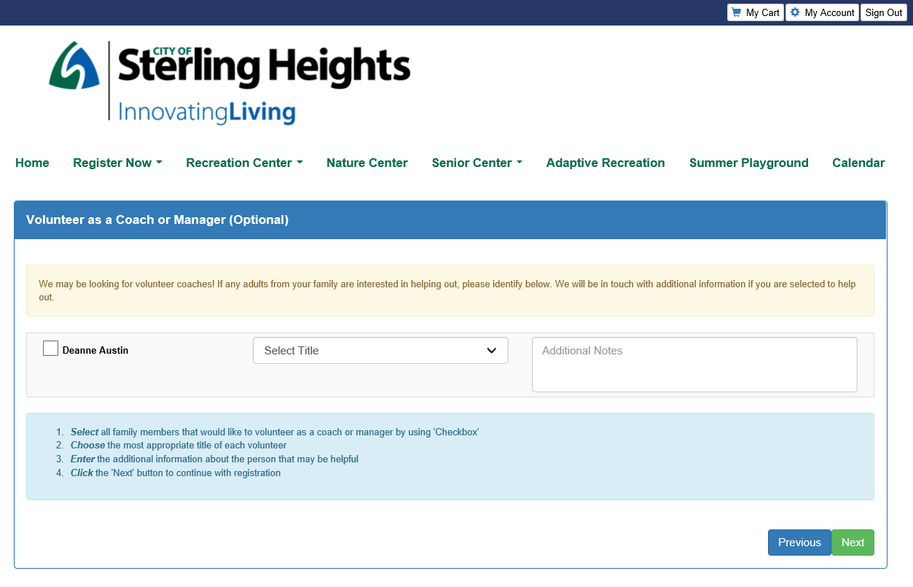
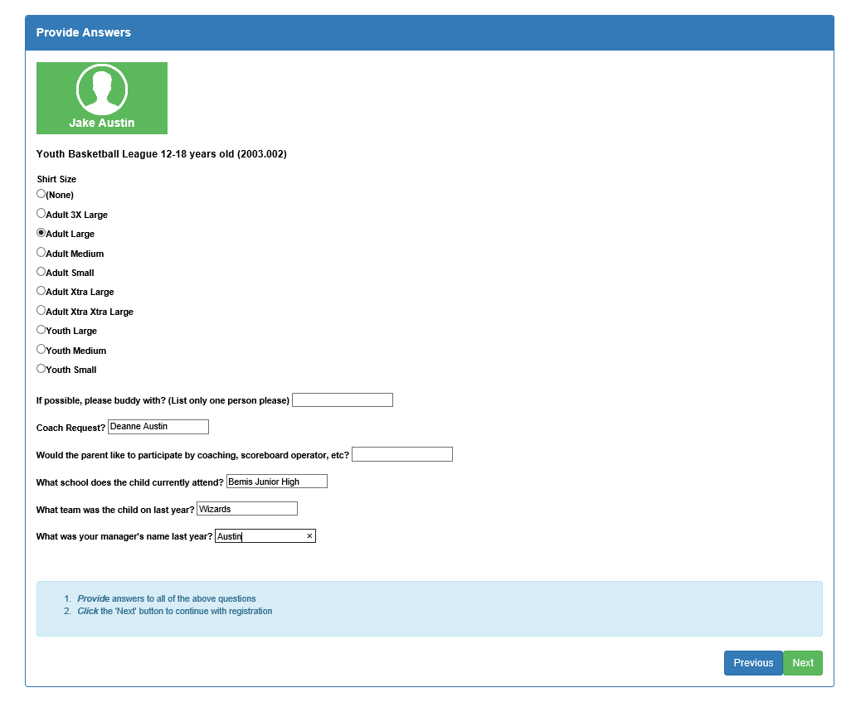
Step 9: Next you may see a Volunteer as Coach or Manager. If you are willing to coach please complete the section. Either way click Next.
Step 10: This is the next screen you will see. Answer the questions and click Next.
Just a note. All boxes must
Contain an answer. If you
Don’t know just put N/A.

Slide 6
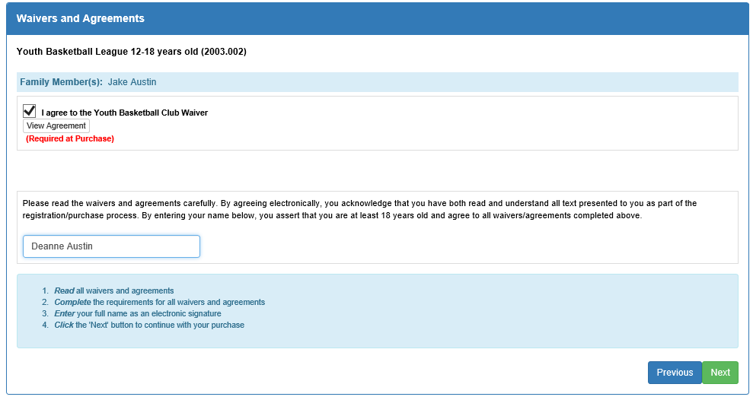
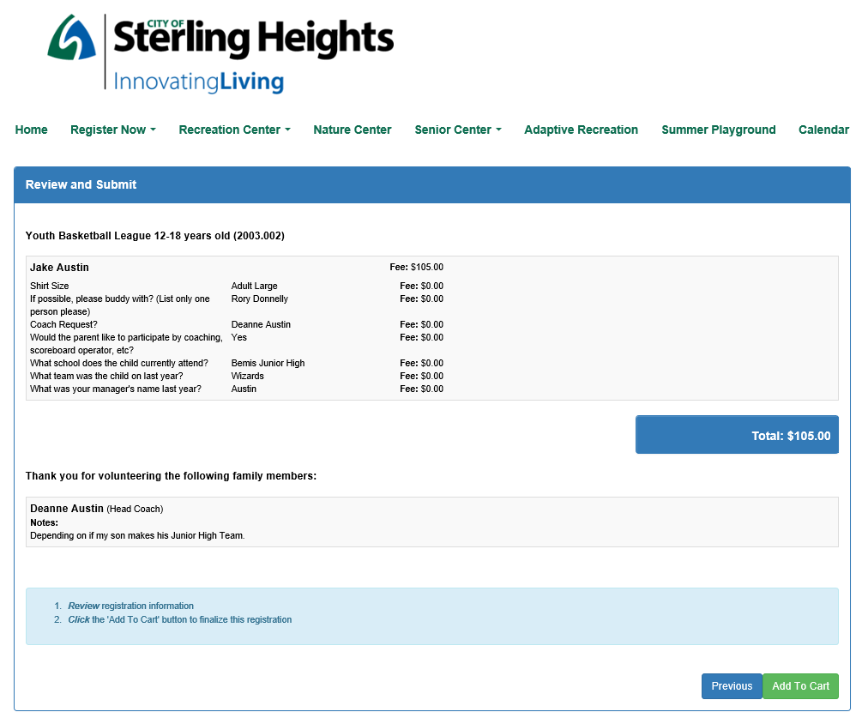
Step 11: The next step is the Waivers & Agreements. Check the box that you agree and click next.
Step 12: This screen you will review and click add to cart.

Slide 7
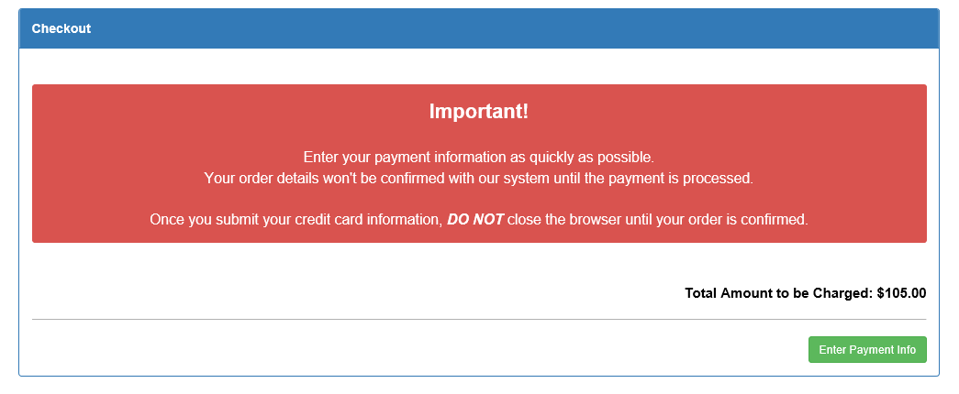
Step 13: Next step is to checkout. So click the green checkout button.
Step 14: Click green Enter Payment Info button

Slide 8
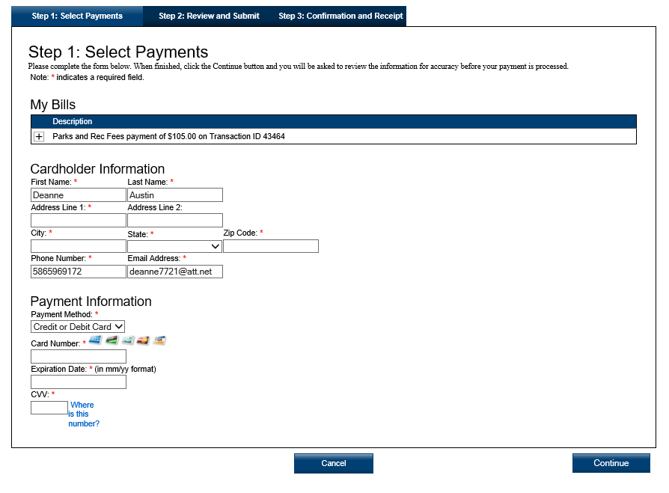
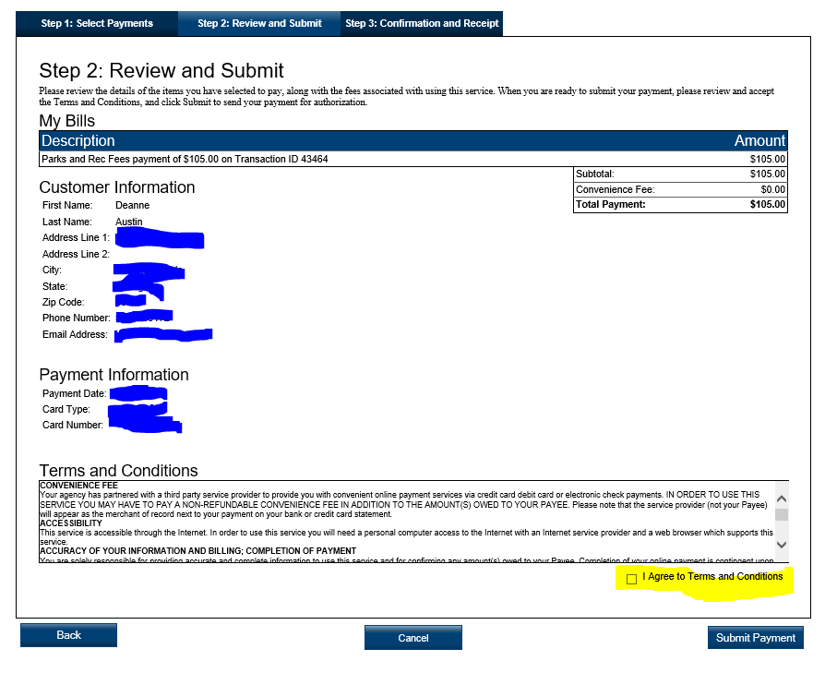
Step 15: Complete your information and click the continue button:
Step 16: Review your information and then check the I agree to Terms and conditions box. Then click submit payment

Slide 9
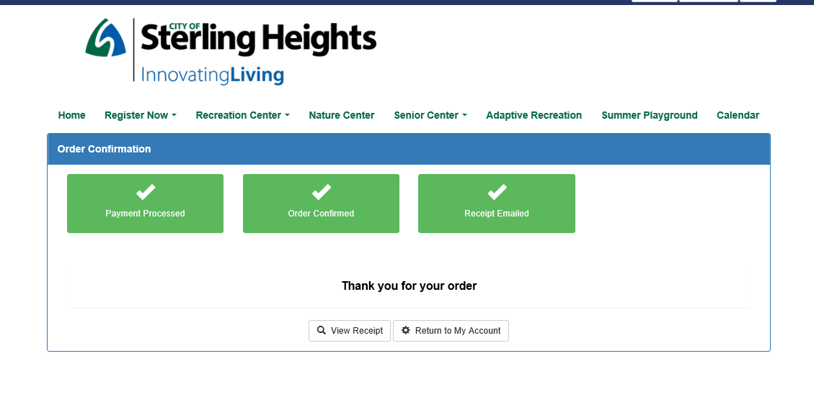
Step 17: This is what you will receive once finished.

